Slide 1
Junior Officials Program Mentor Training Session
Junior Officials Program Committee
Doug Allen (Kentucky)
Robert Gidari (New England)
Mark Heckel (Three Rivers)
Ashley Newton (Kentucky) Co-Chair
Mary Onken (New York)
Cindy Slayton (Georgia)
Phil Sutton (Oregon)
Mike Trego (Indiana) – Co-Chair
Doug Weir (Michigan)
Reg Weissglass (New York)

Slide 2
From the Co-Chairs
We are excited about Launching the Junior Official Program (JOP) in January of 2021. This Training session is brought to you by the JOP
Committee under the auspice of the National Official Committee and the USATF.
This Mentor Training session is required for all would be-mentors, Certification Chairs, Certification Chairs designated Association JOP Chairs, Regional Supervisors to provide a base of understanding and knowledge of the foundations of the JOP.
This document will be posted on the Mentor Training Session link in the next few days. (Oct. 9, 2020) Due to established timelines, the Committee wanted to post the Training Link so that Regional, Chairs, Certification Chairs, Association JOP chairs and the key to the program- Mentors could get started with the needed training and preparation to help implement the program in January 2021.
This training is estimated to be one and one half hours in length (+-). In can be delivered in two parts should you wish to use in a clinic setting in your Association.
The Committee thanks you for your dedication and all that you do for your Association and USATF in general.
What will be your legacy?
Mike Trego (IN) and Ashley Newton (KY)

Slide 3
WE are all in this Together!
What will be our legacy?
The objective of the Junior Officials Program is to educate, train and provide opportunities for USATF members to serve as part of the USATF officiating team; and to promote opportunities to encourage our Junior Officials to continue serving as USATF Officials in the future.
The USATF and the NOC are instituting this effort to provide the necessary longevity of having outstanding officials to continue servicing our track & field programs nationwide on all levels (Association, Region, National and in some cases, Internationally) and in all disciplines from Youth to Masters level.
The Junior Officials Program is under the direct auspice (direction) of the USATF and the National Officials Committee and the expectation is that all Associations will comply to the objectives and implementation of the Junior Officials Program.

Slide 4
Training
Session Packet
This training manual session is for those veteran officials who want to become a mentor in the Junior Officials Program. By signing the Memorandum of Understanding (MOU) form at the end of this Training Packet, you agree to the fact that you have read and discussed this entire document with your Certification Chair(s) /Association Junior Officials Designee, or have attended your Association JOP Mentor Training session and agree to fulfill the duties and responsibilities as outlined in this entire document/or at the Association training session.
You further agree to uphold the USATF policies and practices as outlined in this document as well as that you understand the entire document as presented and take the responsibility to provide a positive learning experience in which the participant will feel safe, secure and instructed properly.

Slide 5
Training Session
Part One
Part One - Overview and Basic Components of the JOP Program
  What is a Mentor?
  What does an effective Mentor do?
  Certification Chair/Designee Responsibilities.
  What are Certification Chairs looking for in a mentor?
  Should I become a Junior Official Mentor Checklist?
  Do I Have what it Takes? – Self-exercise #1
  Objective of the Junior Officials Program (JOP)
  Junior Officials Program
  USATF JOP Requirements. Release of Liability
  USATF/National Officials Committee (NOC) Responsibilities.
  USATF SafeSport Requirements.

Slide 6
Training Session
Part One Continued
Part One – Training Session - continued
  Revisions Made by USATF National Office
  Mentor Program Flow Chart
  Mentor Requirement and Responsibilities
  Discipline Mentors
  Age of the JOP Participants
  Diversity
  Curriculum Purpose
  Study Guides / Plan A / Plan B/ AD
  JOP Participant – Curriculum Expectations
  Yearly JOP Individualized Curriculum Programs

Slide 7
What is a Mentor?
A mentor, in the historical sense, is seen as someone who:
Is a loyal and trusted friend, confident, counselor, and advisor.
Is a teacher, guide, coach and role model.
Is entrusted with the care and education of another.
Has knowledge and advanced or expert status and who is willing to take a personal interest and nurtures a person of talent and ability.
Is willing to giveaway what he or she knows in a non-competitive way.
Represents skill, knowledge, virtue, and accomplishment.

Slide 8
What do Effective Mentor do?
The most effective mentors:
welcome newcomers into the profession and take a personal interest in their career development and well-being.
want to share their knowledge, materials, skill and experience with those they mentor.
offer support, challenge, patience and enthusiasm while they guide others to new levels of competence,
point the way and represent tangible evidence of what one can become.
expose the recipients of their mentoring to new ideas, perspectives and standards, and to the values and norms of the officiating and how to be athlete friendly.
are more expert in terms of knowledge but view themselves as equal to those they mentor.

Slide 9
Certification Chair or Designated Association JOP Chair
Responsibilities
Job Description and Duties
1. Report to the Program Co-Chairs of the Junior Officials' Mentoring Program in conjunction with the Regional Supervisors.
2. Participate in established conference calls/ virtual meetings, etc. with other Regional Chairs or with the program Co-chairs, one call to be held in December, one in April. (Tentative Timeline)
3. Recruit junior officials using developed USATF Junior Official recruiting strategies.
4. Meet with the Local Association Membership Chair to garner list of 14-17 year local Association members. List can be obtained from the USATF Connect website.

Slide 10
Certification Chair or Designated Association JOP Chair
Responsibilities
5. Schedule and present the Mentor Training Session at least once per year, more times than if necessary (virtual). Work with your Regional Supervisor to help establish a calendar of clinics within the Region to be presented. Become familiar with the contents of the Mentor Training Session materials so that your presentation(s) are successful.
6. Recruit mentors within your Region/ geographic area/ Association and orient each mentor to the expectations of the program.
7. Obtain a signed Memorandum of Understanding (MOU) from the new mentor after successful completion of the Mentor Training Session. Keep one copy for records, issue one copy to the mentor, and send one copy to the Regional Supervisors.
8. Obtain a new MOU each year from experienced as well as new mentors. MOU’s last the length of the JOP participant’s Individual Plan. (1, 2, 3, or 4 years). Distribute as indicated in #7 above.

Slide 11
Certification Chair or Designated Association JOP Chair
Responsibilities
9. Link/Assign new officials with mentors. More information contained in the Training Session PPT.
10. Periodically evaluate the success of each mentoring situation. The Program Co-Chairs will work with the Regional Supervisors to develop a viable tool for this action to proceed.
11. Develop and update a master list of mentors and new officials in your Region /Association and forward them to the program co-chairs.
12. Provide constructive criticisms (ways to improve and strengthen) regarding the New Official Mentoring Program to the program co-chairs.
13. Assist in the implementation of change in future mentoring programs.

Slide 12
What the Certification Chairs are looking for when selecting Mentors
Effective mentors share a number of characteristics. The profile sketched below is based on a synthesis of observations described by many mentors and authors. While any single mentor may not possess all of the characteristics, effective mentors have many of these qualities:
Knowledge of Their Field
They are considered by peers to be experts in their field.
They set high standards for themselves.
They enjoy and are enthusiastic about their field.
They continue to update their background in their field.

Slide 13
Further…
Demonstrated Skills in Their Field
Their work demonstrates superior achievement.
They use a variety of techniques and skills to achieve their goals.
Earned Respect of Colleagues
They listen to and communicate effectively with others.
They exhibit a good feeling about their own accomplishments and about officiating.
They recognize excellence in others and encourage it.
They are committed to supporting and interacting with their colleagues.
They are able to put themselves in others shoes and understand their views.
They enjoy helping others.

Slide 14
Should you become a Mentor in the JOP
Program?
As you consider the possibility of serving as a mentor, it is time to stop and ask yourself… "Should I become a mentor?"
The checklist below is designed to guide the self-reflection of individuals who are thinking about becoming mentors. The checklist provides a description of the qualities that are most often thought to be conducive to successful mentoring. Successful mentors generally have many of the qualities listed here, along with some other valuable qualities that are not listed but that are unique to them as individuals.
To use the checklist, respondents should read each statement and place an X in the appropriate column which represents the degree to which the statement characterizes the way the respondent sees himself or herself.

Slide 15
Further…
After ranking each statement (1) Strongly Agree that the statement is representative; (2) Agree; (3) Neutral; (4) Disagree; and (5) Strongly Disagree, respondents may reflect on their own strengths and weaknesses.
Items 1-10 and 15-18 apply to many professional fields while items 11 -14 focus exclusively on the teaching portion of mentoring.
There is no single "ideal profile", but respondents who possess many of these qualities are likely to serve well as mentors. If one has serious doubts about the strength of his or her own qualifications, it might be useful to get a second opinion from a colleague who knows the respondent well.
It is also important to recognize that many of the qualities listed here are developed or learned and the result of practice.

Slide 16
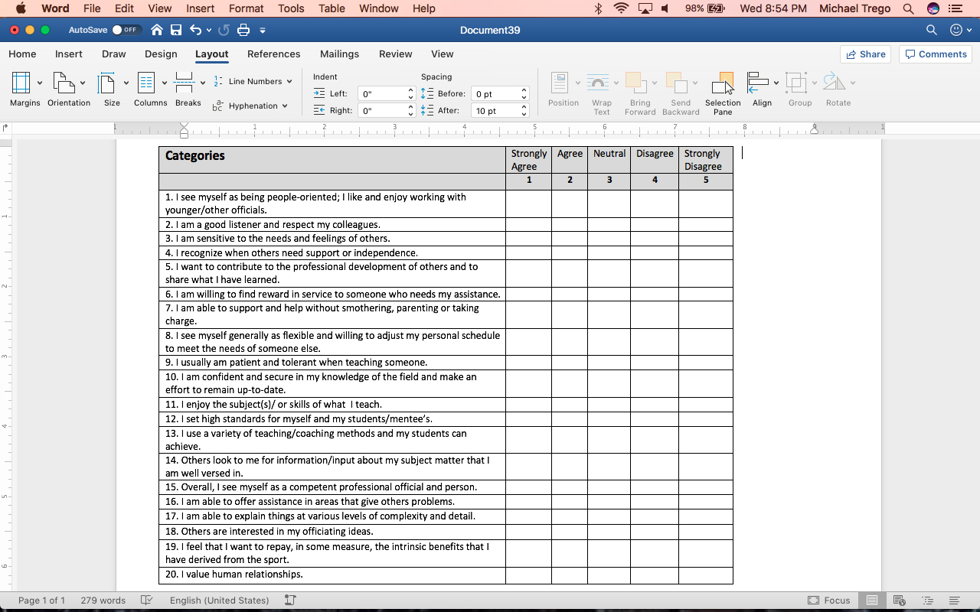
Do You Have What it Takes?
Mentor Quality Checklist - Exercise #1 Please see Session Handout – Suggestions for Charing Expertise on Planning. Onsite activity in Clinic Session.

Slide 17
Junior
Officials
Program
So…What are you getting yourself into by becoming a Mentor in the Junior Official Program?
Let’s take a look at the JOP and see if this is a commitment that you would like to make.

Slide 18
Objective of the JOP
To educate, train and provide opportunities for USATF members to serve as part of the USATF officiating team; and to promote opportunities to encourage our Junior Officials to continue serving as USATF Officials in the future. We are instituting this effort to provide the necessary longevity of having outstanding officials to continue servicing our track & field programs nationwide on all levels (Association, Region, National and in some cases, Internationally) and in all disciplines from Youth to Masters

Slide 19
USATF JOP
Requirements
Participant must be between 14 and 17 years old and it is clearly understood that a Junior Official enrolled in this program IS NOT a USATF Certified Official on any level including “Apprentice”. A permanent curriculum (program learning and performance objectives) has been developed by the National Officials Committee to assure program continuity nationwide.
Must have a current USATF membership and in good standing.
This program will cover competition rules and best practice procedures, philosophy and more.
Develop and maintain professional and ethical guidelines.
This program will provide basic training to prepare them to officiate and fill team assignments, with the exception of shot put, discus throw, hammer throw and javelin throw.

Slide 20
Further…
This program will work with the field officials to set-up/take down venues and other Official duties.
This program will be based on the current USATF Rules.
All Junior Officials in this program will receive a printed copy of the current competition rules.
All Junior Officials in this program will be able to purchase a shirt.
Training must include the successful completion of a Field of Play Evaluation developed by the USATF National Officials Committee as well as a journal.
The program shall be designed on hour/meets attended/ other materials with exposure to all disciplines (outdoor, indoor and cross country programs) if applicable in the association.

Slide 21
Further…
Upon completion of the Junior Officials Program, those who are 18 and have been recommended by their assigned mentor, will be eligible as USATF Certified Officials at the apprentice level after they complete the Officials Certification Training.
Upon completion of a 3 year or a 4 year Junior Officials program, the participant will be eligible to enter as a USATF certified at the Association level official.
All participants must present a valid Permission/Release of Liability Form/Disclaimer developed by USATF (Legal). This form must be maintained in the applicable USATF Association Office and a copy forwarded to the USATF National Office Program Coordinator and Legal Department.

Slide 22
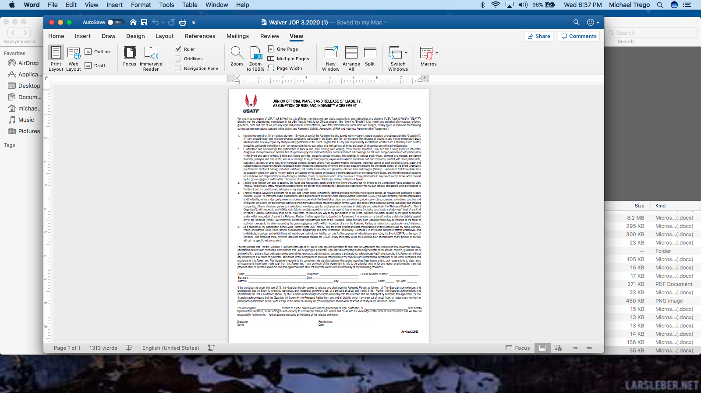
Permission/
Release of Liability Form

Slide 23
Further…
Junior Officials will not be allowed to serve as competition officials at USATF National Championships but will be allowed to assist at the discretion of the LOC Officials Coordinator and under the leadership/mentorship of an approved Certified Official.
Benefits to Participants
Be a part of the sport of Track & Field on an integral level.
Be prepared as one of the future USATF Certified Officials to officiate at a higher level of the sport including Championships on the Association, Region, National and International Levels.
Earn mandatory community service credit hours for your high school.

Slide 24
USATF/NOC
Responsibility
Assign a Coordinator(s)/Certification Chair/Association designee for the implementation of the USATF Junior Officials Program in a nationwide setting.
Mentor must sign a Memorandum of Understanding accepting the responsibility to fulfill the requirements of oversight.
Promote the USATF Junior Officials within the USATF Associations through the Association Certification Chairs, Association websites and other media opportunities.
Maintain a current list of Members in the USATF Junior Officials Program.
Communicate to the Certification Chairs and Associations that once a member has completed the program and indicate the allowable next level of certification opportunity.
Develop a Certificate of Completion to be awarded to those that complete the program.

Slide 25
USATF SafeSport
Requirements
All participants must be current members
All participants must complete the USOC SafeSport Course and agree to abide by the guidelines in the USATF SafeSport handbook
Those certified as USATF Junior Officials will be eligible to officiate Association meets under an adult USATF Certified Official who is at least a National Certified Level in good standing.
A new USOC/USATF SafeSport for Youth is currently being developed and JOP participants will receive that training when offered.

Slide 26
Revisions by USATF National Office
Junior Officials can be certified at Association Level upon completion of program if they have completed 3 or more years.
The number of required meets to participate in is set at four (4) per year.
Experience can include Race Walk, Road Racing, LDR, MUT, and Para-athletics.
Throwing events are still excluded.
Junior Officials will be covered under the same insurance coverage as Certified Officials.

Slide 27
JOP
Implementation Flow Chart
Once the initial mentor training has been completed, people are ready to begin mentoring. But unless some structure is created which guides the course of events and which provides opportunities for mentors as well as their mentees (either together or separately) to share and review their progress, it is easy for mentor programs to lose momentum or to suffer from a lack of direction or communication.

Slide 28
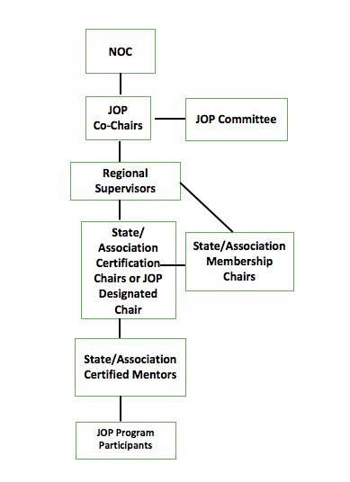
JOP Flow Chart

Slide 29
Mentor Requirement for the JOP
Requirement: The mentor must be a certified official who has certification status is that of a National or Masters Official. However, an Association level official, with three years of experience, may also serve as a mentor. All mentors must be approved by the Association Certification Chair or Association Designee and the Program Co-chairs.

Slide 30
Mentor Responsibilities 1
The mentor must be willing to be responsible for the following:
1. Recruit junior officials and help them enroll and attend USATF clinics.
2. Volunteer to become the mentor for those Junior Officials that your Association recruits.
3. Call the Junior Official after he/she completes the junior officials' clinic to continue the connection that has been made with the Association.
4. Assist the junior official in the selection of meets and the events within each meet that will accommodate their ability to travel, available time, and degree of comfort that they feel for the events and meets they will work.
5. Keep track of the junior official's schedule and make a follow up call after those scheduled meets. Do so after every meet they work during their first season.

Slide 31
Mentor Responsibilities 2
6. Telephone frequently (at least twice per month - minimally)
7. Make the Junior Official feel that they can contact you at anytime. This can be accomplished by telephone calls/ emails /instagram /snapchat to the junior official, at the frequency indicated above, as well as stress to the junior official that he/she is welcome to contact the mentor whenever they need to do so.
8. Take time to assist the junior official at meets at which you are both attending.
9. Encourage the junior official to work many of the same meets you will be working.

Slide 32
Mentor Responsibilities
3
10. Encourage the junior officials to provide most of the dialogue during mentor/junior official conversations.
11. Work cooperatively with other Discipline Mentors in providing a positive learning environment for the JOP participant.
12. Introduce the junior official to other officials at every opportunity and attempt to make important social connections with those veteran officials.
13. Role model to the junior official the proper way to relate to the athletes during competition and other times outside of competition.
14. Prepare the junior official on ways that they may settle protests, disagreements, requests and demands by the athletes and their coaches, and objectionable behaviors which may occur at an event they work.

Slide 33
Mentor Responsibilities
4
15. Reinforce the mental preparation of the junior official in regards to their own personal safety during meets as well as the safety of athletes, coaches, and other people who may be involved in the meet.
16. Stress the importance of preparing oneself from the elements of heat, sun, cold weather, and work schedule.
17. Assist in acquiring the needed rulebooks, resource books, and other track and field publications.
18. Assist with obtaining the proper equipment for events the new official will work which may include clipboard devices, writing instruments, chalk, rubber bands, tape measures, colored markers, levels, flags, announcing equipment, and etc.
19. Assist in obtaining the proper uniform dress for meets including the shirts, badges, pants, shoes, socks, hats, outerwear, and etc.

Slide 34
Mentor Responsibilities
5
20. Facilitate the understanding of the rules as they apply to each event and each level of competition as the junior official has questions that they cannot answer. In the event that you may not have the answer, connect them with other veteran officials with knowledge you may not possess. Have the veteran official call the junior official and assist them and thereby increase the number of contacts for the junior official.
21. Help determine the events that the junior official will eventually specialize by encouraging the junior official to observe, or work, as many differing events as possible during the season.
22. Reinforce their experiences with constructive criticisms and be sure to praise their work often.

Slide 35
Mentor Responsibilities
6
23. Assist them in understanding the requirements that they will need to fulfill to reach advanced officiating certification.
24. Provide contact information for all junior officials they are mentoring to the regional coordinators.
25. Report developmental progress of the junior officials to the regional coordinators on a monthly basis. See the Mentor Check-list for each discipline.
26. Inform them that the service they receive by way of the mentor program will be evaluated at the end of the year and to be thinking of ways that the program could be improved to help junior officials who join the USATF Associations in the future.

Slide 36
Discipline Mentors
1
Discipline Mentors –
Rotation of JOP Participants
The question comes to mind…”What about an assigned mentor who has little or no experience with the event(s) that his assigned JOP Participant is assigned to work? ”. This idea brought about the concept of establishing a “Discipline Mentor” at each of the venues/topics that are covered by the 17 Study Guides.

Slide 37
Discipline Mentors
2
With Discipline Mentors assigned to each venue the JOP participant could then simply rotate from their assigned venue to a different venue. This effort will create a smoother transition from one event to another. In our recruiting efforts of assigned mentors, we would need to fill each event with a trained Discipline Mentor.
We are surmising that it may take 10+ trained mentors per meet to adequately cover the needs of the JOP participants. Not all events in the Study Guides may be offered at any particular meet. The mentor will work with the assigned JOP participant over the timeline of their program to cover all events.

Slide 38
Discipline Mentors per Meet
3
Number of trained mentors at the different venues that will be needed to ensure a smooth transition from venue to venue during any particular Meet would include the following:
Umpire | Long Jump
Starter | Triple Jump
Clerk | Combined Events
Finish Line Lap Scorer | LDR/CC/Road Racing
High Jump | Race Walking
Pole Vault | Meet Management
 | Wind Gauge

Slide 39
Good Question
What type of adolescent person will you be working with?

Slide 40
Age of the JOP Participants
Age of JOP Participants – Born since 1995
Before your read any further, you need to read this section of the training to acquire an understanding of what are some of this age groups typical social, learning, and personalities look like, sound like, and how they act. The following characteristics offer an insight:
Technology native
Focused on authenticity
Entrepreneurial
Educated
Multicultural
Socially progressive
Just remember…not all the backgrounds of all the participants may fall into these categories.

Slide 41
This Age Group
(1) is…
all about technology.
wants instant gratification and they know if that if they need information, it's easily accessible.
Being connected makes communication virtually limitless.
it's not uncommon for members of this age group to have friends all over the world.

Slide 42
This Age
Group
(2) is…
infamous for being the first generation that can’t clearly recall a time before the Internet. These digital natives are defined by their persistent use of smart devices, love of social media, and all things digital – more than 60% of their time is spent online. In fact, a Business Insider article revealed that this age group favorite pastime involved something that makes use of technology.
may be one of the reasons why many people believe this generation struggles with face-to-face interactions. This is a myth, this age group seek out face-to-face 43% of the time.

Slide 43
This Age Group
(3)…
primarily use technology as a way to communicate and stay connected – although they grew up with instant communication online, they understand the value of genuine relationships. Also they embrace technology to make their tasks more efficient, leaving more time for the face-to-face communication and in-person meetings that matter.
cares about the world. They're acutely aware of environmental, political, and socio-economic problems that societies face today. And according to a study by The National Retail Federation and IBM, they're “more serious about this” than any other generation.

Slide 44
This Age Group
4…
cares about the collective good and well-being. But they also care about everyone having the chance to be who they are in their lives.
freedom of expression is vital to and they want to support people and groups that are real (i.e. authentic)

Slide 45
Diversity of JOP
Participants
This age groups marks the last generation in U.S. history where a majority of the population is white. Given the shifting demographics of the country, they do not focus as much on someone’s color, religion or sexual orientation as some of our older generations might. To a them, a diverse population is simply the norm. What they care about most in other people is honesty, sincerity and—perhaps most important—competence.
Indeed, they have been shaped by a society that celebrates diversity and openness. A black man occupied the White House for most of their lives, and they view gay marriage as a common and accepted aspect of society.
If you cannot accept these premises…Please consider not becoming a mentor in this program.

Slide 46
Mentors for this Age Group…
will also need to recognize that members of this age group crave structure, goals, challenges and a way to measure their progress.
After all, their perceived road to success has been mapped out for them their entire lives.
At the same time, it’s important to be aware of the potential for burnout among young overachievers—and to incorporate fun and breaks into the work environment and provide access to healthy escapes focused on relaxation and stress relief.

Slide 47
Mentors will …
need to realize that immediate feedback is the best to encourage knowledge and skill growth.
need to know what you think and how soon they can receive constructive criticism on their performance.
need to make sure that you have your checklist of knowledge and skills and that your mentee has the same list.
as you check-off their performance, make sure that they are also keeping track on their checklist.
need to explain to them how and why they did well or that they need to improve in some aspect of their performance.

Slide 48
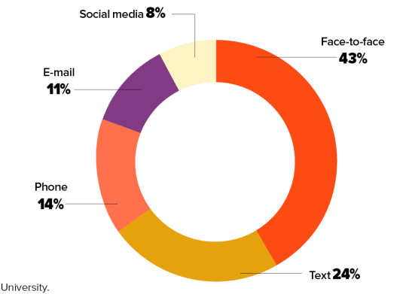
Communicating as Mentors
Communicating with your JOP Participants

Slide 49
Communicating Expectations
In fact…one of your first communications in developing your relationship with the JOP participant will be expectations of communication.
Here are some samples for your thought process.
The frequency of contact, the availability and the accessibility of the mentor and recipient.
The amount and kind of support that are needed by the recipient or that can be provided by the mentor.
The various roles the mentor finds comfortable: listener, supporter, advisor, guide, counselor, role model, friend, nurturer or resource in the background. Many other roles might be identified.
The range of roles the recipient will find natural: listener, observer, initiator of requests for help or guidance, need for nurture or autonomy, self-expectations as peer or coequal. Many other roles might be communicated.

Slide 50
More Good Questions?
Ask yourself…Is this an age of someone I can share my skills with so that they are successful?
“Am I well versed in being able to communicate with this age participant in the social realm in which the “live”?

Slide 51
Curriculum Purpose
1
The fundamental purpose of curriculum is to ensure that the Junior Official participants receive integrated, coherent learning experiences that contribute towards their personal, academic and professional learning and development.
Why did the Committee pick the items they picked for inclusion in the Curriculum?
The Committee chose to include:
  the 2020 Competition Rulebook.
  the skills and techniques of the Best Practices of Officials.
  published checklists for participants and mentors for evaluation.
  Incorporate the NOC Code of Ethics and Standards of Performance.
  Solid and viable adolescent educational strategies for learning.
  Field of Play Evaluations at the conclusion of each study guide based on the current Officials Evaluations at select meets.
  a training session for Mentors and Certification Chairs to enhance and ensure a cohesive nationwide program would be implemented.

Slide 52
Curriculum
Purpose
2
In essence, the Committee has developed this curriculum mapping document to document the relationship between every component of the curriculum.
Used as an analysis tool, communication development, and as a planning tool for mentors and certification chairs, will help ensure that the curriculum mapping of Learning and Performance Objectives are provided to each participant in a consistent and positive manner.

Slide 53
Curriculum
Purpose
3
allows mentors to review the curriculum to check for unnecessary redundancies, inconsistencies, misalignments, weaknesses, and gaps;
documents the relationships between the required components of the curriculum and the intended student learning/performance outcomes;
helps identify opportunities for integration among the track and field disciplines;
provides a review of assessment methods; and
identifies what the program participants have learned, allowing mentors to focus on building on previous knowledge.

Slide 54
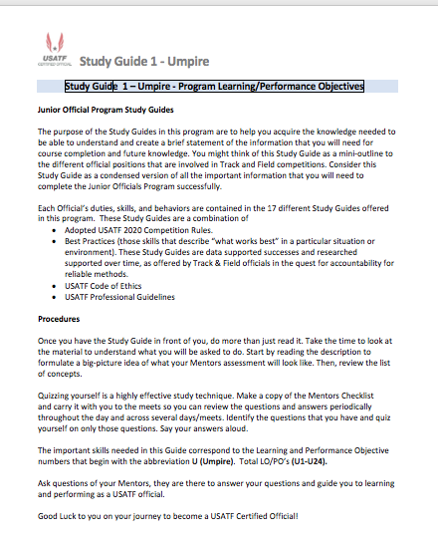
JOP Common Page

Slide 55
JOP
Study Guides
1
Individual Study Guides will be distributed by mentor/available online as the participant progress through the Program, or in multiple sets, depending on the Mentors decision.
Participants should be encouraged to provide a binder/ electronic file to accumulate the what they feel are those important strategies from curriculum over the course of their time-limit commitment.
The idea of the binder/ or electronic file is to build a “Back Pack” of viable strategies they they can take with them, once they have successfully exited the JOP program, for future use as they enter their officiating career.

Slide 56
JOP Study Guides
Common Opening Page
1
The next few slides present the common opening page to all study guides. (Above)
The purpose of the Study Guides in this program are to help you acquire the knowledge needed to be able to understand and create a brief statement of the information that you will need for course completion and future knowledge.
You might think of this Study Guide as a mini-outline to the different official positions that are contained in Track and Field competitions.
Consider this Study Guide as a condensed version of all of the important information that you will need to complete the Junior Officials Program successfully.

Slide 57
JOP Study Guides
Common Opening Page
2
Each Officials duties, skills and behaviors are contained in the 17 Different Study Guides offered in this program. These Study Guides are a combination of:
Adopted 2020 USATF Rules of Competitions.
Best Practices (those skills that describe “what works best” in a particular situation or environment). These Study Guides are data supported successes and researched supported over time, as offered by Track & Field officials in the quest for accountability for reliable methods.
USATF Code of Ethics
USATF Professional Conduct Guidelines

Slide 58
Study Guide Procedures
1
Once you have the study guide in front of you, do more than just read it. Take the time to look at the material to understand what you will be asked to do. Start by reading the description to formulate a big-picture idea of what your Mentor’s assessment will look like. Then, review the list of concepts.
Quizzing yourself is a highly effective study technique. Make a copy of the Mentors Checklist and carry it with you to the meets so you can review the questions and answers periodically throughout the day and across several days/meets. Identify the questions that you don't know and quiz yourself on only those questions. Say your answers aloud.
Ask questions of your Mentors, they are there to answer your questions and guide you to learning and performing as a USATF official.

Slide 59
Study Guide Disciplines
Study Guide 1 - Umpire | Study Guide 7 – Vertical Jumps High Jump | Study Guide 13 – Marshal
Study Guide 2 - Starter | Study Guide 8 – Vertical Jumps Pole Vault | Study guide 14 - Long Distance Running-LDR/CC/Road Racing
Study Guide 3 - Clerking | Study Guide 9 – Horizontal Jumps General Rules | Study Guide 15 – Race Walking
Study Guide 4 – Finish Line/ Lap Scorer | Study guide 10 – Horizontal Jumps – Long Jump | Study Guide 16 – Meet Management
Study Guide 5 – Field Events General Rules | Study Guide 11- Horizontal Jumps – Triple Jump | Study Guide 17 - Wind Gauge
Study Guide 6 – Vertical Jumps Common Rules | Study Guide 12 – Combined Events-General Rules

Slide 60
Which Study Guide to use?
Plan A , Plan B or Plan V (virtual)
The Committee realizing the many different learning styles that adolescents possess, had created two sets of Study Guides.
Each Study Guides contain the following components. Not all study Guides have charts and tables contained within the Study Guides. Many of the needed charts and tables are contained within the Resource section of the Study Guide.
Format of both Plan A and Plan B or Plan V (virtual) Study Guides:
  Rules
  Skills/Techniques/Procedures
  Resources
  Assessment Maps
  Mentor/Participant Checklist of Skills/Procedures
  Field of Play Evaluation for each Study Guide

Slide 61
Plan A
Study Guides
These Study Guides feature all of the formatted items from the previous side in a “complete curriculum” setting that states all of the needed rules, skills, techniques, procedures in a written form.
Each USATF 2020 Competition Rule listed as a part of the JOP program is written out for mentor or participant usage.
This format, essentially, provides a “one-stop-shopping” stop of presenting all of the rules, skills, techniques, and procedures in one study guide.
Plus, the Plan A , as does Plan B and Plan V (Virtual) Study Guides, provide a list of resources that can be accessed by clicking on the Web Link for immediate results.

Slide 62
Plan B
Study Guides
These Study Guides convey a shorter overall format than the Plan A Study Guides, but just present a list of the needed discipline rules, skill, techniques, and procedures by just listing the item itself.
This puts more ownness on the mentor to provide the instruction needed and encourage the JOP to spend time in the rulebook(s), and
In short, total responsibility will be on the mentor and the JOP to have a source for the necessary rules that are required for any particular discipline.
JOP’s will need to be prepared prior to meets in learning the needed skills for the discipline they are studying at any one time.

Slide 63
Plan V (Virtual) Study Guides
The Plan V Study Guides provide yet another knowledge delivery system designed especially for the age group of the JOP Program participants.
Responding to the different learning styles, the AD provides a virtual voice that leads the participants through the 17 Study Guides as presented.
The Plan V Study Guides also follow the format objectives of both the Plan A and the Plan B (shortened) Study Guides.
These are also offered if accelerated participants need a more vigorous program of instruction.
Using combinations of Study Guides is also acceptable.

Slide 64
Three Study Guide Plans
Same Objectives
All three (Plan A, Plan B, and Plan V Study Guides) are formatted in the same learning sequence. These Study Guides provide:
Learning/Performance Objectives for rules needed for the discipline, list of skills/techniques needed, Resources for knowledge and understanding, Reminder Map of Officials Code of Ethics/ Performance Standards, Mentor checklist of needed skills, and a Field of Play Evaluation to be taken at a mutual time as decided on by the JOP participant and the Mentor.
The Study Guides, the mentor, the USATF Competition Rules, and acquired experience working track and field meets are the four key learning components of the Junior Officials Program. Utilizing these four strategies will help you to produce successful JOP Participants.

Slide 65
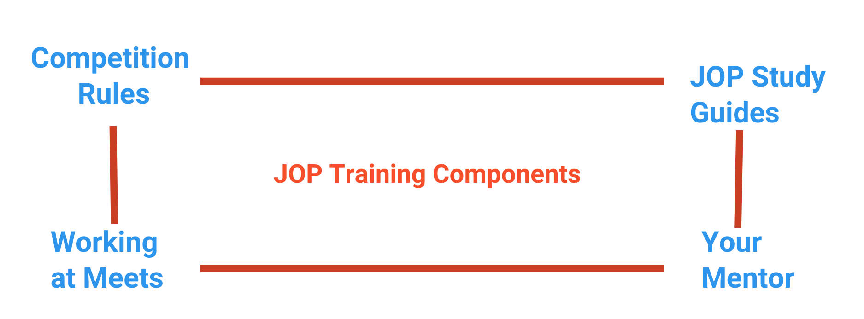
Four way Strategy for Learning

Slide 66
Side-by-Side Comparison
Please do a side-by-side comparison of the three types of Study Guides to help you determine an action plan to discuss with your assigned JOP participant.

Slide 67
Study Guides
As a mentor, one of your tasks is to discern what type of learner your assigned JOP is then discuss with them “how they learn”, and suggest the correct and successful Plan of Study Guides to use in the program.

Slide 68
JOP Participant
Expectations
1
Journals/Back Pack of Strategies
Besides utilizing the learning tool of study guides, the participants will need to produce, over the time-span they are in the program, a journal of their activities or a “Back Pack of Strategies” that they have collected that will help them, not only over the course of the JOP Program, but in their upcoming career as a certified USATF official.
The journal will be a “reflection-collection” from all of their study guides and experiences that they can consider an important reference of their knowledge and skills.

Slide 69
JOP Participant
Expectations
2
The expectation is that each participant will submit a “Log of Meets“ experience that they have “worked at” during the course of their individual program age level.
The minimum requirement for meets per year are four (4). Note: a two (2) day meet would count as two (2) meets. Also, many local Association /Regional meets are 4 days in length. This would equate to a four (4) day meet completion.
The participant must work at least three quarters of the length of the meet to have the meet counted in their log. Mentor initials will verify completion of the meet.
The log must include:
Meet Name | Meet Location | Duties/Job(s)- List the different disciplines worked | Mentor Initials

Slide 70
Yearly Individualized Program
Keeping in mind that there are basically 4 age levels in the JOP Program (14-15-16 & 17 year old), JOP participants will come into the program as either a 4 year participant, 3 year participant, 2 year participant, or a 1 year participant.
Curriculum programs have been developed to address the age of the participant when they enter the program.
Obviously, the more years in the program, the more disciplines can be learned.
Note: 3 or 4 year participants can be awarded an Association Level status upon successful completion of the program.
Note: 1 or 2 year participants can be awarded an Apprentice Level status upon successful completion of the program.

Slide 71
4 Year Program of Disciplines
(14 year olds)
Four Year plan (14 year old) (Can come it as an Association Level Official)
Year of the program | Study Content | Study Guides incorporated | Total number of Study Guides per year
Year 1 | Umpire/Starting/Clerking/Finish Line-Lap Scorer | 1,2,3,4 | 4
Year 2 | LDR, Race Walking, Wind Gague/ Combined Events General Rules, Marshal) – Plus review of year 1. | 12,14, 15,17, | 4
Year 3 | Field Events General Rules, Vertical Jumps Common Rules, High Jump, Pole Vault, VJ General Rules, Plus review of year 1, & 2 | 5,6,7,8,9 | 5
Year 4 | Field Event General Rules, Long Jump, Triple Jump/ Meet Management Plus review of year 1, 2, & 3, | 5,10, 11, 16 | 4
 | Total Study Guides covered |  | 17 total

Slide 72
3 Year Program of Disciplines
(15 year olds)
Three Year Plan (15 year old) (Can come in as an Association Level Official)
Year of the program | Study Content | Study Guides incorporated | Total number of Study Guides per year
Year 1 | Umpire/Starting/Clerking/Finish Line-Lap Scorer/Marshal | 1,2,3,4,13 | 5
Year 2 | LDR/Race Walking/Wind Gauge/ Combined Events General Rules/Meet Management – Plus Review of Year 1. | 12,14, 15, 16,17, | 5
Year 3 | Field Event General Rules/ HJ/PV General Rules/High Jump/Pole Vault/ Horizontal Jumps General Rules/ Long Jump/Triple Jump.- Plus review of Year 1, & ­2 . | 5,6,7,8,9,10,11 | 7
 | Total Study Guides covered |  | 17 total

Slide 73
2 year Program of Diciplines
(16 year old)
Two Year Plan (16 year olds) (will come in the Apprentice Level Official)
Year of the program | Study Content | Study Guides incorporated | Total number of Study Guides per year
Year 1 | Umpire/Starting/Clerking/Finish Line-Lap Scorer/Marshal/LDR/ Race Walking/Wind Gauge/ Meet Mgmt. | 1,2,3,4, 13,14,15, 16, | 8
Year 2 | Field Event General Rules/ Vertical Jumps General Rules/High Jump/Pole Vault/ Horizontal Jumps General Rules/Long Jump/Triple Jump/ Combined Events GR/Marshal | 5,6,7,8,9,10,11,12,17 | 9
 | Total Study Guides covered |  | 17 total

Slide 74
1 Year Program of Disciplines
(17 year old) Pick a trac to follow
One Year Plan – (17 year old). Working under the same premise of the 5 credentialed areas…the 17 year old may have to “Declare a Track trac or a Field trac or a LDR-Off Track//Race Walking/Marshal trac.
Year of the program | Study Content | Study Guides incorporated | Total number of Study Guides per year
Year 1 | Track Events trac: (Umpire/Starting/Clerking/Finish Line-Lap Scorer/Combined Events GR/Marshal | 1,2,3,4,12,14 | 6
Year 1 | Field Events trac: Field Event General Rules/ Vertical Jumps Common Rules/High Jump/ Pole Vault/ Horizontal Jumps General Rules/Long Jump/ Triple Jump/ Combined Events GR/Marshall | 5,6,7,8,9,10,11,12,14 | 9
Year 1 | LDR/RW Trac:LDR Off-Track/Race Walking/Marshal /Meet Management/ Wind Gague | 14,15,16,17,18 | 5
 | Total Study Guides covered |  | 5-9 total

Slide 75
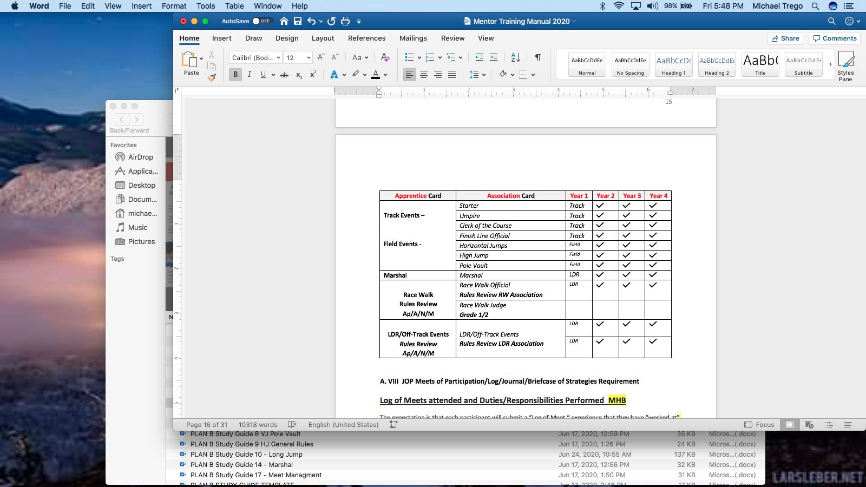
Program Disciplines Relation to
Credential Cards
2021-2024

Slide 76
Training Session
Part Two
Junior Official Program

Slide 77
Mentoring to any age Official
The following section is in itself a stand alone training for any age official be they JOP age, Young Officials, or New Officials to your Association.
Please feel free to us any parts of this entire training when working with those types of officials just mentioned.
The Study Guides are also set to be used by any age official, whether new, young, or old as a foundational level so that they can acquire the needed skills to become a knowledgeable and effective official.

Slide 78
The Nuts and Bolts of
Mentoring
The following slides give a more detailed practical aspect of the the Art of Mentoring.
In creating your Mentoring Plan (ideas and strategies that you will need in working with the Junior Officials Program) the following information will serve you well as a foundation for your task.
As experienced official, you have a great wealth of experiences and skills to offer to the JOP participant.
By utilizing some of the following information, you can construct a viable “plan of action” in working with your JOP.

Slide 79
Training Session
Part Two
Part Two: Formal Mentor Training Bolts!
Is the Training of Mentor Really Necessary ?
Types of Learners you will encounter.
The Four Mentor Relationship Stages
Ways of Mentoring
Strategies for Sharing your Expertise – Examples
Communication – Support – Challenge
Communication Checklist
Various Kinds of Support
Joys of Mentoring
Avoiding the Risks of Mentoring
Purposes and benefits of the Mentor Program
Memorandum of Understanding

Slide 80
Is Mentor Training Necessary?
1
Mentors can have a significant impact upon the professional development of aspiring young or mid-career officials.
Whether a mentor's impact is positive or negative depends in large part upon how well informed and skilled the mentor is, and upon the mentor's commitment and availability.
It seems only natural to ask: Is training to be a mentor really necessary?
Research at the University of California, Irvine, suggests that training is not only important to the success of mentoring relationships but that it can be directed toward the most difficult challenges faced by mentors.

Slide 81
Is Mentor Training Necessary?
2
When mentor with one, two or three years of experience as mentors were asked "Do you think mentors need to be trained?", one in five (20%) thought training was unnecessary. Their comments, which are illustrated here, generally reflect the view that mentoring is a natural extension of teaching. They suggest that mentoring essentially is normal teacher-talk, but talk that takes place between two people in a mentoring relationship.
"The best mentoring is on a one-to-one basis where neither party thinks of himself as a mentor (or recipient). Untrained mentors are probably less threatening."
"Enthusiasm is difficult to infuse or train someone to have. If a mentor is good, he will have fun mentoring or teaching others, even peers."

Slide 82
Is Mentor Training Necessary?
3
Yet the majority of mentor teachers (80%) surveyed expressed the view that training would be helpful.
"Where do mentors/teachers get the skills to work with adults? Very few people are 'natural' mentors. Training would be valuable, especially to have others share what works for them."
"The personality for mentoring--that nurturing personality--comes naturally, but the nurturing quality becomes focused by training."
"Mentors need training so that they can feel more confident about helping others. They need to know how to help officials who need help but will not actively seek help."

Slide 83
Is Mentor Training Necessary?
4
”Helpful" doesn't mean "necessary."
A better way to understand the need for mentor training is to examine the difficulties that mentors encounter while fulfilling their roles.
When asked, "What are the most difficult aspects of mentoring for you?" most mentors cited examples which illustrated the need for basic information and training…such as…

Slide 84
Is Mentor Training Necessary?
5
"Making the initial contact and building trust. Sharing my ideas at first....I don't want to sound like a know-it-all even when I am asked for help."
"Overcoming my hesitation to tell (the recipient) that he is wrong and to suggest alternatives. I feel like I am offending him."
"Trying to explain (to the recipient) that her instructions were too difficult. I helped her revise it but certain parts were still too difficult. When do you stop correcting and revising? When does helping become hurting?"
Rejection, I offered help at her convenience but my help wasn't wanted.... It's hard to help people."
"Working with someone for a whole year and then finding that he can't make it."

Slide 85
Is Mentor Training Necessary?
6
All of these responses suggest a need for basic information about mentoring relationships or for mentor training.
The candid and sensitive responses of these mentors point to the value of some preparation for their role as mentors and the value of specific skills that allow mentors to feel confident and successful as they fulfill their expectations and goals as mentors.

Slide 86
Types of Learners
Four (4) Major Types
We all experience the world in unique ways, and with that comes variation in the ways we learn best.
Understanding the differences in these types of learning styles can drastically impact the way teachers handle their students, set up group projects and rally behind individual learning.
Without understanding the disparity in learning styles, mentors might end up with a handful of students lagging behind their classmates/Peers—in part because their unique learning style hasn’t been activated.

Slide 87
Types of Learners
#1
Learning styles and preferences take on a variety of forms—and not all people fit neatly into one category as there’s plenty of overlap between styles. That being said, most learners align with the following styles: There are basically 4 types of learners:
1. Visual Learners - How to recognize visual learners ?- Someone with a preference for visual learning is partial to seeing and observing things, including pictures, diagrams, written directions and more. This is also referred to as the “spatial” learning style. Students who learn through sight understand information better when it’s presented in a visual way. Examples: List makers, students who like to take notes.

Slide 88
Types of Learners
#1 - Visual
How to create understanding for VISUAL Learners ?- Mentors should create opportunities to draw pictures and diagrams on the board (See Plan A Study Guides) or ask students to doodle examples based on the topic they’re learning.
Mentors catering to visual learners should regularly make handouts and use presentations. (See Best Practices/ Resources) Visual learners may also need more time to process material, as they observe the visual cues before them.
So be sure to give students a little time and space to work through the information.

Slide 89
Types of Learners
#2 - Auditory
2. Auditory Learners - How to recognize auditory learners ?- Auditory learners tend to learn better when the subject matter is reinforced by sound.
These students would much rather listen to a lecture (Explanation) than read written notes, and they often use their own voices to reinforce new concepts and ideas.
These are the students who like to read out loud to themselves, aren’t afraid to speak up in class and are great at verbally explaining things.
Additionally, they may be slower at reading and may repeat things a teacher tells them.

Slide 90
Types of Learners
#2- AL
How to create understanding for auditory learners ?- Since these students can sometimes find it hard to keep quiet for long periods of time, get your auditory learners involved in the lecture by asking them to repeat back new concepts to you.
Ask questions and let them answer. Invoke group discussions so your auditory and verbal processors can properly take in and understand the information they’re being presented with.
Watching videos and using music or audiotapes are also helpful ways to engage with auditory learners. (See Plan V Study Guides).

Slide 91
Types of Learners
#3 - Kinesthetic
3. Kinesthetic Learners - How to recognize kinesthetic learners? - Kinesthetic learners or “tactile” learners learn through experiencing or doing things.
They like to get right in the thick of things by acting out events or using their hands to touch and handle in order to understand concepts.
These are the students who might struggle to sit still, might be good at sports or like to dance, need to take breaks when studying and might not have great handwriting.

Slide 92
Types of Learners
#3 - KL
How do you create understanding for a kinesthetic learner? –
The best way mentors can help these students learn is by getting them moving. (Working at the meets).
Mentors should instruct students to act out the skills/procedures they are teaching. Have them demonstrate to you.
Additionally, mentors should encourage these students by incorporating movement into lessons: pacing to help memorize, or learning skills that involve moving around the track/field facility.
Once these students can physically sense what they’re studying, abstract ideas and difficult concepts will be easier to understand.

Slide 93
Types of Learners
#4- Reading/ Writing
4. Reading/Writing Learners – How do you recognize reading/writing Learners? –
reading/writing learners prefer to learn through written words. (Plan A Study Guides).
While there is some overlap with visual learning, these types of learners are drawn to expression through writing, reading articles on the internet, writing in diaries (Journals and Back Packs), looking up words in the dictionary and searching the internet for just about everything.

Slide 94
Types of Learners
#4 – R/WL
How do you create understanding for reading/writing learners? –
This is probably the easiest learning style to cater to since most of the educational system provides lots of opportunities for writing in journals, doing research online and reading books.
Allow plenty of time for these students to absorb information through the written word, and give them opportunities to get their words out on paper as well. (Pack Pack)

Slide 95
Types of Learners
Recap
Pinpointing how a child learns best can dramatically affect their ability to connect with the topics you’re teaching/ mentoring, as well as how they participate with the rest of their peers.
The JOP Program and the Study Guides have been designed to incorporate all of the types of learners that you may encounter in your mentoring experiences.

Slide 96
How People Learn
Educational Research tells us that this is how people learn:
10% of what we read…
20% of what we hear…
30% of what we see…
50% of what we see and hear…
70% of what we discuss…
80% of what we experience…and
95% of what we teach others…
We instruct according to our individual learning style! So what is your learning style? Interesting.

Slide 97
The Four Mentoring Relationship
Stages
One way to view the evolutionary nature of mentoring relationships is to think of them in terms of stages of development.
There are four basic stages of mentoring relationship development.
Here is the quick definition and then we will discuss each Stage…

Slide 98
Mentoring Relationships
Stage 1
The mentor and recipient become acquainted and informally clarify their common interests, shared values and professional goals.
Occasionally matchmakers who assign mentors to recipients can foresee "mentor marriages made in heaven," but more often mentors and recipients prefer to choose one another.
Taking time to become acquainted with one another's interests, values and goals (Stage 1) seems to help mentoring relationships gain a better start than when such activity is given a low priority.

Slide 99
Mentoring Relationships
Stage 2
The mentor and recipient communicate initial expectations and agree upon some common procedures and expectations as a starting point.
In the very few cases where a major disparity is found to exist between the needs and expectations of the two individuals-- and where neither party can accommodate to the other--the pair is able to part company on a friendly basis before the actual mentoring and inevitable frustration begins. If you feel there is a clash of personalities that you cannot overcome…let your Cert Chair/Association JOP Chair know immediately.

Slide 100
Mentoring Relationships
Stage 3
Gradually, needs are fulfilled.
Objectives are met.
Professional growth takes place.
New challenges are presented and achieved.
This stage may last for months or years.

Slide 101
Mentoring Relationships
Stage 4
The mentor and recipient redefine their relationship as colleagues, peers, partners and/or friends.
Clarifying Expectations in Mentoring Relationships
Most professionals place a high value on taking the initiative to clarify their own expectations and to understand the expectations of others.
This quality contributes to the establishment of strong and positive mentoring relationships.

Slide 102
Looking at the Four Mentoring Relationship Stages
In this next section, a more in-depth look at the four stages of Mentoring is presented along with Strategies and Ideas for you to consider when working with the JOP participants.

Slide 103
The Four Mentoring
Stages – Stage 1
Stage One – Interests/Values/Goals
The mentor and recipient become acquainted and informally clarify their common interests, shared values and professional goals.
Occasionally matchmakers who assign mentors to recipients can foresee "mentor marriages made in heaven," but more often mentors and recipients prefer to choose one another.
Taking time to become acquainted with one another's interests, values and goals (Stage 1) seems to help mentoring relationships gain a better start than when such activity is given a low priority.

Slide 104
Stage 1
At the same time, mentoring relationships differ in an important way from other personal relationships because they are professional in nature.
Mentors are responsible for conveying and upholding the standards, norms, and values of officiating. (USATF Officials Code of Ethics).
They are responsible for offering support and challenge to the recipient of their mentoring while the recipient strives to fulfill the profession's expectations.

Slide 105
Stage 1
Healthy mentoring relationships are evolutionary rather than static in nature.
They change because the purpose of the relationship is to enable the recipient to acquire new knowledge, skill, and standards of professional competence.
The perceptions of both members of the relationship evolve as the recipient's performance evolves to new levels of competence under the mentor's guidance and support.
The person who once said, "No man steps into the same stream twice," could very well have been describing the changing nature of mentoring relationships.

Slide 106
Developing Common Expectations
Stage 2
The mentor and recipient communicate initial expectations and agree upon some common procedures and expectations as a starting point. In the very few cases where a major disparity is found to exist between the needs and expectations of the two individuals-- and where neither party can accommodate to the other--the pair is able to part company on a friendly basis before the actual mentoring and inevitable frustration begins.
Most professionals place a high value on taking the initiative to clarify their own expectations and to understand the expectations of others. This quality contributes to the establishment of strong and positive mentoring relationships.

Slide 107
Examples
Stage 2
The frequency of contact, the availability and the accessibility of the mentor and recipient.
The amount and kind of support that are needed by the recipient or that can be provided by the mentor.
The various roles the mentor finds comfortable: listener, supporter, advisor, guide, counselor, role model, friend, nurturer or resource in the background. Many other roles might be identified.
The range of roles the recipient will find natural: listener, observer, initiator of requests for help or guidance, need for nurture or autonomy, self-expectations as peer or co- equal. Many other roles might be communicated.

Slide 108
Matching in Mentoring Relationships
1
Historically, individuals who have desired to become mentors have looked over aspiring newcomers in their profession or event and have selected promising young protégés to nurture. Most of the time, these mentoring relationships work out very well.
Occasionally they do not, and the protégé moves on in search of another mentor or the mentor seeks another protégé.
What should individuals who are contemplating a mentoring relationship look for during the exploratory stages of getting to know one another and sharing expectations? Several important factors are considered be considered…(Next Slide)

Slide 109
Matching in Mentoring Relationships
2
Degree of eagerness to have a mentoring relationship.
Similarity in personal styles: gregarious, animated, spontaneous, vs. low-key, retiring, reflective.
Similarity of expected officiating assignments, or events and responsibilities.
Similarity in preference for nurture vs. autonomy when establishing expectations for support
Similar original background in Officiating, common professional area or interests.

Slide 110
Matching in Mentoring Relationships
3
What if choice is not an option?
Most professionals view the term "professional" to mean, among other things, that one is able to rise above personal considerations, differences or desires when providing service to those who need one's professional help or expertise.
Thus, among professionals, any match in a mentoring relationship should be productive.
While some freedom of choice is desirable if choice is possible in mentoring relationships, many situations do not offer this opportunity.
Where mentors are not free to choose the recipient of their mentoring, they might expect--with preparation or training for the role--to be equally as effective as mentors who choose their protégés but who have no preparation for this role.

Slide 111
Ways of Mentoring Stage 3
Every mentor has a specific body of professional knowledge and skill to share. (Discipline Mentors).
To illustrate, in the teaching profession a part of this pedagogical knowledge is referred to as "content."
The content or subject matter to be taught to the participants--for example, judging the Race Walk-- must be transformed from the rule book level to a form that is appropriate for the readiness level of each individual JOP participant.
In other words, the subject matter must be repackaged to fit the students' maturational, developmental or age/grade level, and the range of previous experiences the students are likely to have had.

Slide 112
Ways of Mentoring Stage 3
Experienced mentors develop a sense of how well an individual, or various groups of students, will understand specific subject matter when the content is presented at different levels of complexity.
They are able to "repackage" the content to fit different needs. Similarly, mentors use a variety of teaching methods, each adopted to achieve a specific outcome.
Every profession has its own content or body of knowledge in the field and the variety of methods practiced when professionals utilize their knowledge in service to others.

Slide 113
Strategies for Sharing Expertise on Planning
1
Please see Session Handout – Suggestions for Sharing Expertise on Planning. Onsite activity in Clinic Session.
Find out how you can be the most helpful in the area of planning/preparing for an event.
Team up during the orientation or initial training period or before and schedule regular times to meet for discussion and planning sessions.
Discuss goals for the year or season and objectives for level of knowledge.
Describe various officiating climates and environments at events that you have observed or created and how these variations worked out.
Review the expectations of the officiating level and events being worked on and discuss how they can be woven into the mentoring plan.

Slide 114
Strategies for Sharing Expertise on Planning
2
Share catalogs, articles, and monographs, for events of interest and how to order any instructional materials, rulebooks or officiating equipment.
Show how you organize your schedule for the year, the seasons, the week and the day for each event of interest.
Share your ideas about planning for contingencies at a venue.
Talk about how and where to anticipate officials or athletes' errors and misconceptions.
Describe the labor saving steps you use in preparing and instruction to athletes that pay off later in reduced workload, problems or protests.

Slide 115
Strategies for Sharing Expertise on Planning
3
Talk about the patterns of athletes' physical, social and skills development in your events; and demonstrate your understanding and valuing of differences among the various officiating skills and duties in their events.
Describe alternative strategies that are successful for learning where athletes or officials have diverse or conflicting needs.
Collaborate on a special unit of instruction or a project.
Work together to assign officials to best positions based on their skill levels and your needs as head of the event.
Share shortcuts, officiating monographs or outlines, assignment sheets, instructions for athletes and officials that have worked well for you.
Offer to share your contacts, websites or computer software or show where such information can be found.

Slide 116
Strategies for Sharing Expertise on Officiating
1
Please see Session Handout - Suggestions for Sharing Expertise on Officiating. Onsite Clinic
Structure times at noon or the end of the meet to share reactions to the day's events or problems, explaining the alternatives and why the particular alternative was chosen or should have been chosen. Provide opportunities for the mentee to talk about any officiating concerns and to ask questions.
Listen with interest when he or she talks about when giving instructions or explaining a call and if asked, offer your own reaction or analysis and support.
Be willing to share information about your own officiating successes and failures, if appropriate.

Slide 117
Strategies for Sharing Expertise on Officiating
2
Volunteer to receive an evening or early morning phone call in an emergency.
Talk about timing, pacing and sequencing in athlete instructions, particularly concepts that are difficult for the mentee to master or grasp. (Older age JOP)
Offer to demonstrate techniques or forms live.
Discuss several kinds of athlete instruction that work best with various levels of athletes; explain the rationale for using each of the various approaches.

Slide 118
Strategies for Sharing Expertise on Officiating
3
Describe strategies you use to increase athletes' attention, motivation or participation.
Talk about "brick walls" and "roadblocks" that particular groups or all athletes encounter, and share your strategies for helping them students move forward.
Offer to prepare to videotape (on your phone) lessons or formal classes and offer to give feedback if he or she has any questions. Post pictures in SnapChat ask the JOP first).
Brainstorm a wide range of solutions that might be fitting for common problems.

Slide 119
Strategies for Sharing Expertise on Event or Meet Management
1
Please see Session Handouts - Suggestions of Sharing Expertise on Meet Management. Onsite Clinic.
Take time to listen to concerns about meet or event management or operations.
Ask what kinds of feedback on event management would be most useful.
Discuss standards for venue management/Athlete decorum while on the field of play and share strategies for meeting those standards.
Talk about the importance of organizational routines and describe the routines that contribute most to event management.

Slide 120
Strategies for Sharing Expertise on Event or Meet Management
2
Describe ways to let athletes know you understand their needs and concerns, and demonstrate ways to link that knowledge with long-range and short-term planning.
Share examples of ways to enhance students' self-concepts.
Talk about the most difficult management problems you have encountered and various ways to address them.
Describe techniques you tried that didn't work and analyze why they didn't work.

Slide 121
Strategies for Sharing Expertise on Event or Meet Management
3
Talk about standards of meet-wide conduct. (Sportsmanship)
Demonstrate a wide range of meet management techniques--either live or on videotapes.
Offer to analyze (as a colleague and peer) the videotape of a new official's performance in the area of event management, and be willing to share your own videotapes.
Share exemplary officiating books or workshop materials on event and meet management techniques.

Slide 122
Strategies for Sharing Expertise on Evaluation
1
Please see Session Handout – Suggestions for Sharing Your Expertise on Evaluation.
Onsite Clinic Activity
Listen to the mentee's concerns about evaluation and share ideas about the overall purposes of evaluation at the meet.
Talk about the variety of ways (formal and informal, verbal and nonverbal) that one can evaluate the official's learning and attitudes in specific subjects or at specific age group levels.
Share the program system for evaluation and record keeping, and describe other models that you know about.
Collaborate on the development of tests or reviews that might be used in identical or similar events.

Slide 123
Strategies for Sharing Expertise on Evaluation
2
Offer to share a collection of tests or other evaluation measures you have developed.
Offer to give feedback on the mentee's evaluation instruments and their results.
Review the standardized test program used by the association or national, and talk about its role in relation to curriculum planning and evaluation of student learning in the field.
Describe various strategies to handle the expected paperwork associated with mentoring assignments.

Slide 124
Strategies for Sharing Expertise on Evaluation
3
Explore various approaches for when and how to sharing evaluation results with officials, mentoring head and certification chair.
Discuss and compare various techniques for evaluation of one's own mentoring effectiveness.
Help the new official to prepare for the review and evaluation of his or her first year of officiating at the end of the season.

Slide 125
10 Great Strategies that Work for Mentors
Remain Objective.
Be honest with the new official.
Be a model to the new official.
Be deeply committed to the new official.
Be open and transparent.
Be a teacher to the new official.
Believe in the new officials’ potential.
Envision the new officials’ future.
You must be successful in the new officials’ eyes before they will listen to you.
Be teachable...model teachability.

Slide 126
Communication- Support and Challenge
The effectiveness of verbal and nonverbal communication is high on the list of important factors that contribute to the success of mentoring relationships--and of all professional and personal relationships.
Mentors have a special responsibility for effective communication because they are a primary source of information, support and challenge to the recipients of their mentoring.

Slide 127
Communication- Support and Challenge -2
The Officials Committee depend so much upon effective communication to accomplish its mission that it needs to frequently provide training in communication skills for its National and Master level members.
Such training may focus on the enhancement of specific communication skills or a wide variety of them.

Slide 128
Communication- Support and Challenge -3
The essence of training is communication: of knowledge, of skills, of values, of attitudes and of expectations.
Thus, the quality of communication at and before meets affects all that happens in officiating and the achievement of their goals and objectives.
Everyone associated with officiating including new officials, event heads, referees, mentors, meet administrators, athletes, the Officials Committee, and the National Committee depend upon the clear expression of goals, objectives and points of view in order to engage in any cooperative activity.

Slide 129
Importance of Communicating
As you think about the importance of communicating support and challenge to recipients of your mentoring skills, it is helpful for them to review a checklist that focuses on the key features of effective communication.
Such checklists are most meaningful when individuals make them up for themselves. An example of a communications checklist appears next.
Please see Clinic Session Handout

Slide 130
Communication Checklist for Mentors - 1
How do I perceive myself in the many roles a mentor plays?
How well do I understand the recipient's overall expectations for our mentoring relationship?
In general, is my communication with him or her effective, including verbal and nonverbal communication?
What is my objective in this specific conversation or message?

Slide 131
Communication Checklist for Mentors - 2
Does my delivery mode (face-to-face, phone, written communication) fit my purpose?
Am I too formal or informal for the purpose of this communication?
What assumptions have I made or shared in this communication?
What kind of response do I expect from the recipient?
Am I prepared for a very different kind of response?

Slide 132
Communication Checklist for Mentors - 3
Have I given him or her enough time to respond, to ask questions or to ask for clarification?
If I think I have been misunderstood, can I clarify and paraphrase?
Am I willing to set aside my own communication agenda to listen to his or hers at any time?
How should I react to his/her communication to further our mentoring relationship?

Slide 133
Various Kinds of Support
Please see Clinic Session Handout.
Support can be communicated in many ways.
Mentors find it helpful to make a list of the various kinds of support they are comfortable providing as they share their expertise.
The examples below illustrate a few ways that mentors communicate support.

Slide 134
Various Kinds of Support - 1
A nod of the head, a smile, or a wink at a tense moment.
A compliment, a pat on the back, or a hug after a challenge has been met. **SS
A coffee/water break or lunch together at a time when the mentee needs to talk.
An opportunity to spend an evening together reviewing the results of a task or planning for the next one. **SS

Slide 135
Various Kinds of Support - 2
An invitation to visit a clinic together, a map to a good bookstore across town, or a shared ride to some event. **SS
Information about ways to gain the support of key individuals.
Suggestions for acquiring scarce resources or equipment.
An invitation to a weekend barbecue or small get-together with other JOP participants and their families... Maybe sponsored by the local Association?**SS

Slide 136
Growth Needs of JOP’s
Mentors also need to offer their mentee’s challenges that stimulate professional growth and cause them to stretch.
Challenges lead to the development of new levels of expertise.
When the amount of challenge is well matched to the mentee's readiness for growth, the tasks become motivating.
Challenges that are not matched well with the individual's level of development can be overwhelming and create feelings of being unable to cope.
Then, rather than producing growth, the challenge may lead to frustration, panic or feelings of failure.

Slide 137
Growth Needs of JOP’s
It becomes important then, for mentors to become sensitive to the growth needs of those to whom they mentor, and attempt to offer optimal challenges for their mentee’s professional development.
Some mentors develop mentoring plans to help maintain optional levels of challenge for the mentee.
“This meet/year you perform these tasks. Next meet/year we look to tackle these objectives/performance tasks”

Slide 138
Mentoring –
Stage 3
Establishing a positive mentoring relationship is very much like establishing other valued human relationships in a number of respects.
Both parties usually have a genuine desire to understand the values and expectations of the other person, and to respect and become sensitive to one another's feelings and needs.
At the same time, mentoring relationships differ in an important way from other personal relationships because they are professional in nature.
Mentors are responsible for conveying and upholding the standards, norms, and values of officiating.
They are responsible for offering support and challenge to the recipient of their mentoring while the recipient strives to fulfill the profession's expectations.

Slide 139
Mentoring Stage 4
The mentor and recipient redefine their relationship as colleagues, peers, partners and/or friends.
Clarifying Expectations in Mentoring Relationships .
Most professionals place a high value on taking the initiative to clarify their own expectations and to understand the expectations of others.
This quality contributes to the establishment of strong and positive mentoring relationships.

Slide 140
Joy of Mentoring
1
Since childhood many of us have been reminded that: "It is better to give than to receive." And in many languages and cultures, the idea has been expressed that: "It is not what we give but what we share. For the gift without the giver is bare."
Both ideas capture an important aspect of mentoring: that many joys and benefits result from sharing one's expertise, one's time, and one's self.
The most obvious of these joys come bounding in the form of appreciation that others express for mentoring assistance.
A different kind of joy accrues when others value our expertise so much that they incorporate our ideas into their own thinking and behavior.

Slide 141
Joys of Mentoring
2
And then quite unexpectedly still a third kind of joy emerges when, in the midst of sharing our expertise with others, we rediscover long-buried feelings of pride and accomplishment that were forgotten--feelings that occurred when we first mastered our craft for ourselves.
As mentors we often learn new and different approaches as we prepare and share out expertise. These are just a few of the joys of mentoring.
When mentors where asked what their most rewarding experiences were as mentors, and whether they were glad they had served as mentors, they replied with statements like those that follow .

Slide 142
Joys of Mentoring
3
As a mentor, what were your most rewarding experiences?
"Seeing her excitement and enthusiasm--watching her gain insights into concepts that are difficult for a student to learn."
"His comments, his requests for assistance, and the fact that he returned week after week was incentive enough for me to prevail in the face of countless hours of my own preparation."
"Helping a beginning official so that he decided to stay in the profession for a second year."
"They (new officials) told me that I unknowingly role-modeled a lesson idea and event management techniques, and they voluntarily and successfully adapted these ideas."

Slide 143
Joys of Mentoring
4
"The greatest reward was helping him to understand where the pitfalls are in the event and how to instruct the athletes and coworkers to avoid the problems."
“Having her report how well the athletes responded to techniques I had shared with her."
"The overwhelming appreciation I receive! And watching them grow into colleagues and competent officials."
"Getting her to realize and accept the idea of being a good referee is the art of communication: knowledge without necessarily communicating skills or the details of how to accomplish the mission."
"Watching him try out and expand the ideas that we planned together!"

Slide 144
Avoiding the Risks of Mentoring
Are there risks associated with mentoring?
The answer is, "Relatively few," if risks are thought of as the lack of predictability and personal control over events that could harm us in some way.
Fortunately the major risks associated with mentoring can be avoided or reduced through knowledge and planning.
…If you Fail to Plan…Plan to Fail!

Slide 145
Risk Awareness and Prevention
What are the risks and how can they be avoided or reduced?
Four of the most commonly mentioned risks--or fears of risks--are identified below and illustrated by examples of comments often made by mentors and would-be mentors.
Brief descriptions are offered of the kinds of knowledge or actions that help to avoid such risks or to reduce fears of them.

Slide 146
Mismatch between Mentor and participant
1
Mentors express this fear with statements like: "Our personal styles may clash.”
“We may not be able to work together.”
“I'm afraid I will overpower or threaten him. “
“She has become too demanding and too dependent. “
“Can he take honest, well-intentioned criticism?"

Slide 147
Threat to one’s Officiating Image
2
This concern is expressed by statements like: "I may be misunderstood; he, she, or my colleagues may think I'm a know-it-all.
“If she fails to make the grade in spite of my mentoring, people may begin to wonder about my own competence.”
“I could be responsible for his success or failure!"

Slide 148
Knowledge and Action – Officiating Image
3
Individuals who are familiar with the multiple roles that mentors can play avoid stereotyped perceptions of mentors and their participants, and can help to dispel misconceptions about the degree of responsibility a mentor has for the success or failure of the recipient of the mentoring.
It is always helpful to remember that many persons contribute to the development of any new or advancing official. (Discipline Mentors)
Wise mentors encourage such broadly based support and avoid over-identifying with the success or failure of their mentee.

Slide 149
Failure as a Mentor
4
Mentors express this fear or concern with statements like, "I might get in over my head.”
“I'm trying to help, but maybe I'm hindering her. “
“What works for me may not work for anyone else.”
“Should I let him make mistakes that can be avoided so that he can profit from them?"

Slide 150
Knowledge and Action – Failure as a Mentor
Knowledge of successful mentoring techniques contributes to the professional growth of both individuals in a mentoring relationship, and thus, decreases the likelihood of frustration, failure or fear of failure for either member.
More than 50 mentoring techniques are suggested in Slides 112-134 Strategies of Mentoring.

Slide 151
Knowledge and Action
The development of a mentoring plan can increase the sense of personal control that both members of the relationship have or may need.
Such plans can identify in a systematic way the frequency and times of regular meetings or get-togethers and the topics or issues to be covered.
A mentoring plan helps to remind everyone concerned that becoming a good official is a developmental process.
And at the end of a year, both members can look back at the plan and recognize the participant’s growth.

Slide 152
Competition of a Rivalry
Fear of competition or rivalry is evident in statements like: "He may be more talented than I am--can I handle professional jealousy?”
“I have shared my best secrets and strategies with her and now she is surpassing me! “
“How will his or her success affect my status or opportunities?"

Slide 153
Knowledge and Action
Competition or rivalry can be destructive to any mentoring relationship.
Knowledge of the evolutionary nature of mentoring relationships helps to prepare everyone for changes in a relationship
Occasionally a few mentoring relationships last for a professional lifetime; but more often mentoring relationships are of much shorter duration because of other changes in officiating careers and organizations.

Slide 154
Continued
When the mentor's guidance no longer seems to be needed and the emerging or advancing official begins to demonstrate expert competence and knowledge, the wise mentor takes the lead in redefining the relationship.
Such leadership generally leads to a mutually rewarding respect for one another, and the mentor can then take justifiable pride in his or her contribution to the professional development of another individual.

Slide 155
In Closing
When you wake up in the morning you have two choices – go back to sleep and dream your dreams, or wake up and chase those dreams.
What will you hand down that a predecessor official has done for you, to the new/JOP officials that will eventually fill the ranks? Its’ your legacy. Have you thought about what your legacy will be as a person, as a husband, as a friend, as a USA Track and Field official? When your time is done…who will sing your song when you are gone?
This would be a great time to have that discussion with yourself…if you have not already done so.
What do you want the heritage of USA Track and Field Officials to be? Its’ never too late to build a legacy…be a mentor!

Slide 156
Congratulations
Congratulations on completing this training session.
Read on!

Slide 157
How to verify your Mentor Training pg.1
Now that you have the knowledge of the program and have read and discussed this training session with your presenter, the final step in becoming a mentor in the JOP program is you fill out the Memorandum of Understanding that is contained in your Handout Packet for this onsite training session or at the link on the next slide. Please fill out and return to your Association Certification Chair at your first opportunity.
The Certification Chair/JOP Association Chair will consider your application and confirm with you if you have been accepted as a JOP Mentor.
Those of you have completed this training online will need to fill out the link to the Memorandum of Understanding that is contained at the end of the training slides and submit it to your Association Certification Chair/JOP Association Chair at your first opportunity. You will be notified if you are accepted as a JOP Mentor.

Slide 158
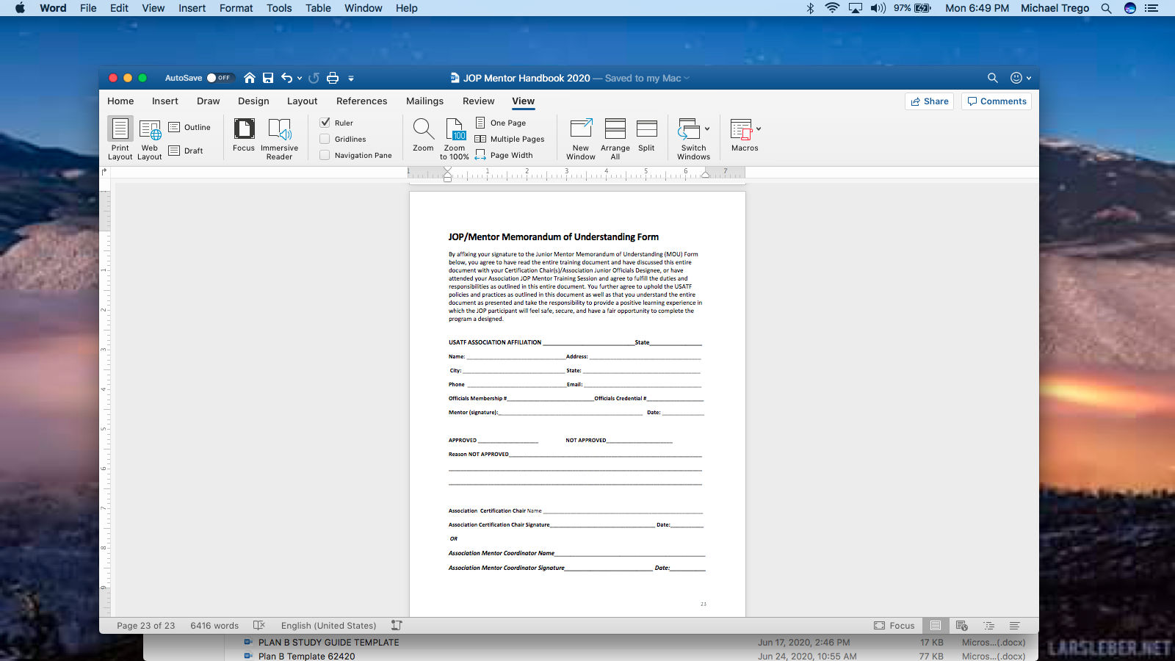
MOU Form
Link to MOU.

Slide 159
From the JOP Committee
If you have any questions at all about any part of the program, either contact your Association Certification Chair/Association JOP Designee, your Regional Supervisors, or contact Mike Trego (IN) (mikeogert@gamil.com) / 1-765-661-1645 or Ashley Newton (KY) (flaming_roses@hotmail.com) / 1-502-741-6937 Committee Co-Chairs.
Thank you for your commitment and support of the Junior Officials Program.
Thanks to you it will work! When your time is up…who will tell your story?
What will be your legacy? After you have gone…You will sing your song?
Mike Trego / Ashley Newton – Co-Chairs and the Junior Officials Committee Members

